Slide 1
Access Arrangements Current issues and developments
­­
BATOD East
4th July 2018
Paul Simpson
BATOD NEO

Slide 2
Overview
Who am I?
Principles of access
Specific access arrangements
Current issues
New online course

Slide 3
Who am I?
Principles of access
Specific access arrangements
Current issues
New online course

Slide 4
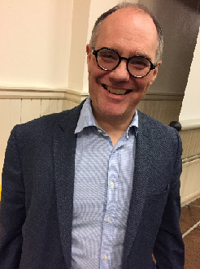
Who am I?
Teacher Mary Hare School
housemaster for 95 deaf boys aged 11 - 19
Peripatetic Teacher of the Deaf
Leicestershire and later Oxfordshire
University Lecturer
Birmingham training Teachers of the Deaf

Slide 5
Who am I?
Head of service for deaf and vision impaired children in West Sussex – sensory support team
Head teacher primary school for the deaf
Governor/Trustee
formerly of two special schools for deaf children
computerised tomography

Slide 6
Who am I?
Author of educational publications
for Teachers of the Deaf
Teacher primary resource base for deaf children
National Executive Officer of BATOD
Vice-President of FEAPDA

Slide 7
Who am I?
Principles of access
Specific access arrangements
New online course
Current issues

Slide 8
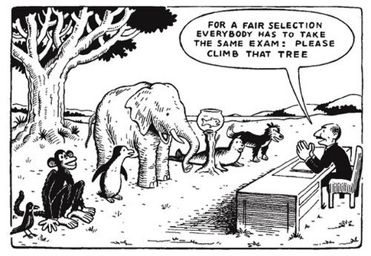
Assessment - an old favourite

Slide 9
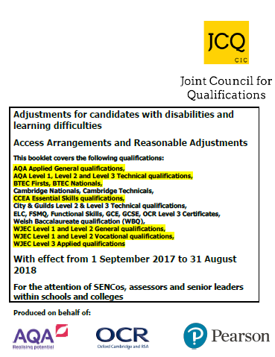
Key document

Slide 10
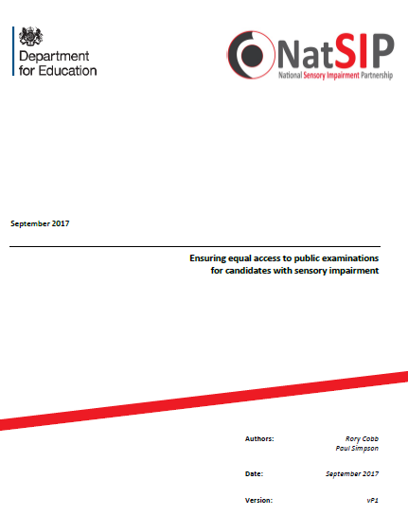
NatSIP publication

Slide 11
Principles
Fair access – level playing field
Not concessions
Not automatic
Normal way of working

Slide 12
Who am I?
Principles of access
Specific access arrangements
Current issues
New online course

Slide 13
25% Extra Time
AAO
Evidence of need
Persistent difficulties, impact, involvement of teaching staff, avoid substantial disadvantage, NWoW
Letter from specialist service

Slide 14
25% - 50% Extra Time
AAO – rejection
Strong justification
In cases of very substantial disadvantage

Slide 15
Modified Language papers
More and more papers modified at source with BATOD trained modifier input
“checked for accessible language”
Or ordered through AAO
.

Slide 16
Feedback
Deaf Education/Policy and Reforms/Access arrangements/Language modification feedback for BATOD and Exam Boards

Slide 17
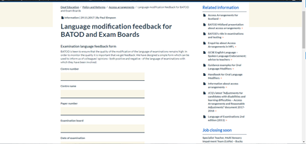
Modified Language papers
.

Slide 18
BSL Interpretation
No AAO and no evidence required
NWoW
Not MFL or English apart from rubric
Candidates can only fingerspell individual words
Extra time to be considered
Advance opening
Modified language papers

Slide 19
Oral Language Modifier
Most vulnerable AA
Rare and exceptional
AAO
Score <69 comp/vocab
Malpractice – technical terms
Extra time granted
Separate invigilation
Modified language papers
Form 6A
May use SSE, BSL, CS
Advance opening

Slide 20
Oral Language Modifier
must have:
accredited training (inspected)
good working knowledge of English grammatical structures
subject knowledge
command word knowledge and examiner expectations

Slide 21
Oral Language Modifier
A fully qualified Teacher of the Deaf may act as an Oral Language Modifier without the need to successfully complete accredited training

Slide 22
Scribe
AAO
Controversial area
In Scotland it is permitted
Not forbidden but not encouraged
Evidence of need

Slide 23
Live voice presentation
Not AAO
NWoW
Persistent and significant difficulties following speech at normal speed
Must consult specialist teacher
Extra time up to 25% considered
Advance opening

Slide 24
Exemption
Agreed before examination with AO
Last resort
Not undermine integrity
Whole components
No more than 40%
GQs only
Refer through AAO

Slide 25
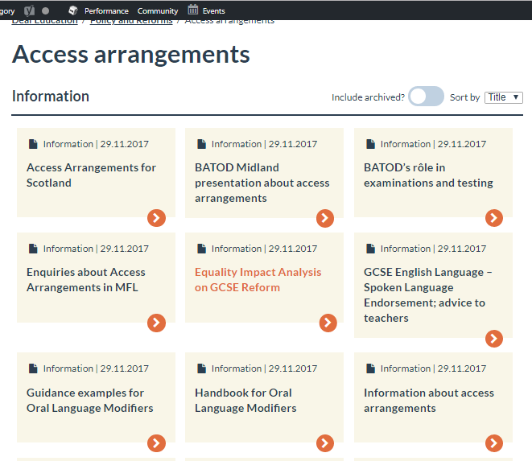
Website pages Deaf Education/Policy and Reforms/Access arrangements

Slide 26
Who am I?
Principles of access
Specific access arrangements
Current issues
New online course

Slide 27
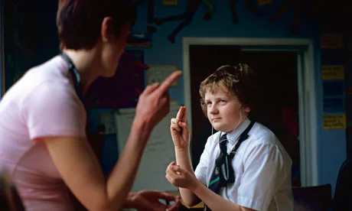
Current issues
OLMs
Readers
Specialist assessors
Language modification
BSL Interpreters

Slide 28
Ofqual Equality Act 2016 s96
/www.salesian.com
to seek views on whether or not to specify to prohibit the use of Oral Language Modifiers (OLMs) as a reasonable adjustment

Slide 29
Reader
https://www.planitplus.net/JobProfileImages/455.jpg
50% extra time if computer reader not permitted.
Is this discriminatory?

Slide 30
Who is a specialist assessor?
http://inclusive.tki.org.nz

Slide 31
Who is a specialist assessor?
Head of Centre to approve
Relates to learning difficulties
Post-graduate qualification (p82)
Theory of testing, validity, reliability, SDs, curves, percentiles etc.

Slide 32
ToDs as specialist assessors
ToDs do not need to be access arrangement assessors at all, so the requirement to have undergone 100 hours of post-graduate study in assessment mentioned in the JCQ document is not relevant. For all access arrangements for deaf candidates (except OLMs) there is no requirement for a specialist assessor to be involved.
Deaf children fall into the category of candidates with complex needs and just have to satisfy the five conditions in section 5.2.3 on page 26 of the current document (the same wording is used throughout the document to refer to eg scribes, readers etc). This, alongside evidence of the disability (eg an EHCP, statement from a ToD or consultant) is all that is needed as evidence for most arrangements.
In the case of OLMs, the document specifically states that a ToD may carry out assessments of reading comprehension or vocabulary – page 58, 5.11.2.

Slide 33
Modified Language papers
Change of process for OCR
JCQ document

Slide 34
BSL Interpreters
Changing the name from Sign Language Interpreter to
Communication Professional
Centres should video the signing of the Communication Professional to demonstrate accuracy

Slide 35
Who am I?
Principles of access
Specific access arrangements
Current issues
New online course

Slide 36
New online course
Examination Access course for
Sensory Impairments
https://viewweb.org.uk/exam_access/activities/ex_0_0.html

Slide 37
New online course
Introduction Identifying and applying for adjustments Access arrangements for candidates Case studies Introduction to exam modification Test

Slide 38
BATOD Working for all in deaf education!
Thank you
for listening!

