Slide 1
Mental Health and Deafness
– the generic specialism
Dr Deborah Innes

Slide 2
Background
General Adult Psychiatrist
  Qualified doctor
  Specialist training in adult mental health disorder
Special interest in Mental Health and Deafness and Eating Disorders
Six Specialities in Psychiatry including Child and Adolescent Psychiatry

Slide 3
Mental Health and Deafness
Not condition specific
Not speciality specific
Not environment specific (community and IP)
Not treatment specific
Not region specific
Communication specific – BSL users (Deaf and DeafBlind), Acquired hearing loss (Dual sensory impaired)

Slide 4
Scottish Mental Health Service for Deaf People
Deaf/deafened/deafblind adults with mental disorder
Half time Psychiatrist
Whole time and half time Advanced Nurse Practitioner
One session Occupational therapist
Admin support

Slide 5
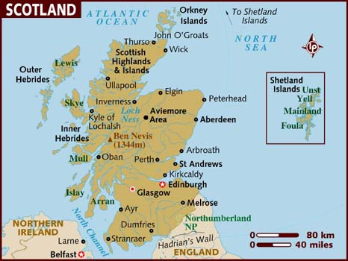
Catchment area

Slide 6


Slide 7
Prevalence of mental health relating to Deaf people
Recent studies looking at mental health of deaf people in the community have found that 38% of deaf people were experiencing some form of mental distress
Notes:
25% in the general population
7

Slide 8
Mental Health and Deafness
Deaf adults appear to suffer the same rates of severe and enduring mental health problems as the population in general.
(Ref, NHS Advisory Service (1998) ‘ Mental Health Services- Forging New Channels, BSMHD)
Deaf people have higher rates of common mental health problems and complex problems (40% vs 25%)
(Ref from Sign of Times quoted in HMSO, 2005, Drug Misuse and People with Hearing Impairment, COI Communications)
Notes:
Quiz using cards

Slide 9
Mental Health & Deafness
No more likely to experience major mental disorders, e.g. Schizophrenia
Higher rates of depression and/or anxiety
Higher incidence of emotional, behavioural and adjustment disorders
More likely to be diagnosed with personality disorder

Slide 10
However
Research indicates that Deaf people who are proud of their identity and identify as part of a Deaf Community experience less psychological problems than those who have a negative attitude towards their deafness
(Ridgeway, 1997)

Slide 11
Mental health issues in Deaf people
Unique pressures over and above those faced by the wider population include:
  Poverty and social exclusion
  Social isolation
  Loneliness
  Difficulties in relationships
  Education
  Inability to hold down employment
  Under employment – 4 times higher
  Lack of access to information
Notes:
Notable – education and employment

Slide 12
Mental Health issues in Deaf people
  Victim of abusive language and gestures
  Low self esteem
  Higher levels of stress due to communication pressure and barriers and ‘breaking the ice’ when meeting new people
  Higher use of alcohol and or drugs to combat loneliness, anxiety, depression, physical pain and self medication
  Mental health problems occur more frequently in deaf children (Sign of the Times)
(Ref HMSO,2005, Drug misuse and People with Hearing Impairment COI communications 2005)

Slide 13
Mental Health & Deafness
Difficulty around diagnosis of condition or assessment of needs
Often misdiagnosed as learning disability

Slide 14
Factors in assessment
Culture
Language
English/Lip Reading/BSL/SSE
Assessment tools
Validity when translated e.g. MMSE, ACE
Communication support
BSL Interpreters/Lipspeakers/Notetakers
Notes:
Culture – general mistrust of hearing authority/medical figures. Ground or first floor.
Language – not always BSL!! BSL – visual gestural language, with regional accents. Pointing, eye gaze, role shift, facial expression
Clip of BSL/SSE/mime
Assessment tools not directly translatable, e.g. watch and words starting with letter p, use B handshape plate, park, true, direct . Research underway to develop and validate ACE.
Appropriate CS not always BSL interpreter, notetaker, lipspeaker, guide communicator

Slide 15

Effect on Mental Health
Effect on assessment
Behaviours
  Touching
  Position
  Environmental noises
  Bodily noises
  Descriptions
  Story telling

Slide 16
Deaf people and voice hallucinations
Do deaf people hear voices?
Researchers prior to 2000 were convinced by evidence of deaf people reporting to ‘hear’ voices.
This research used non-native signers or hearing researchers.
Atkinson J et al; 'Exploring the perceptual characteristics of voice-hallucinations in deaf people', Cognitive Neuropsychiatry 2007, 12:4, 339 – 361

Slide 17
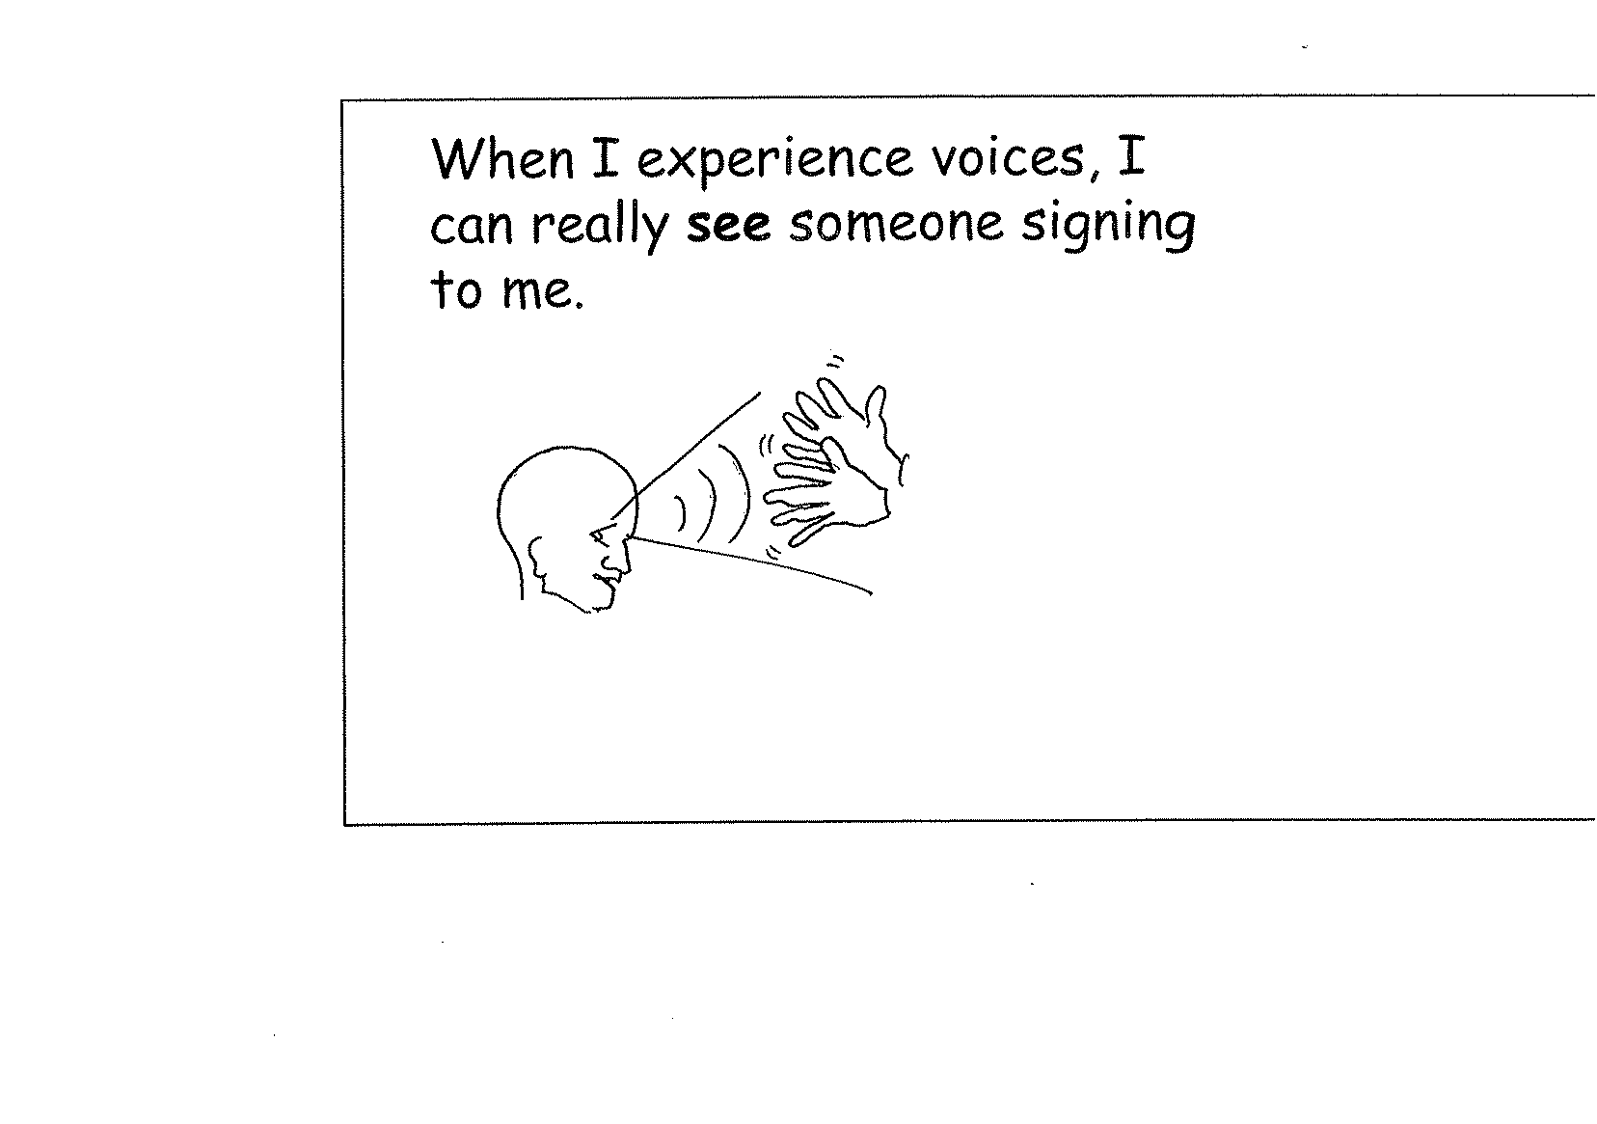

Slide 18
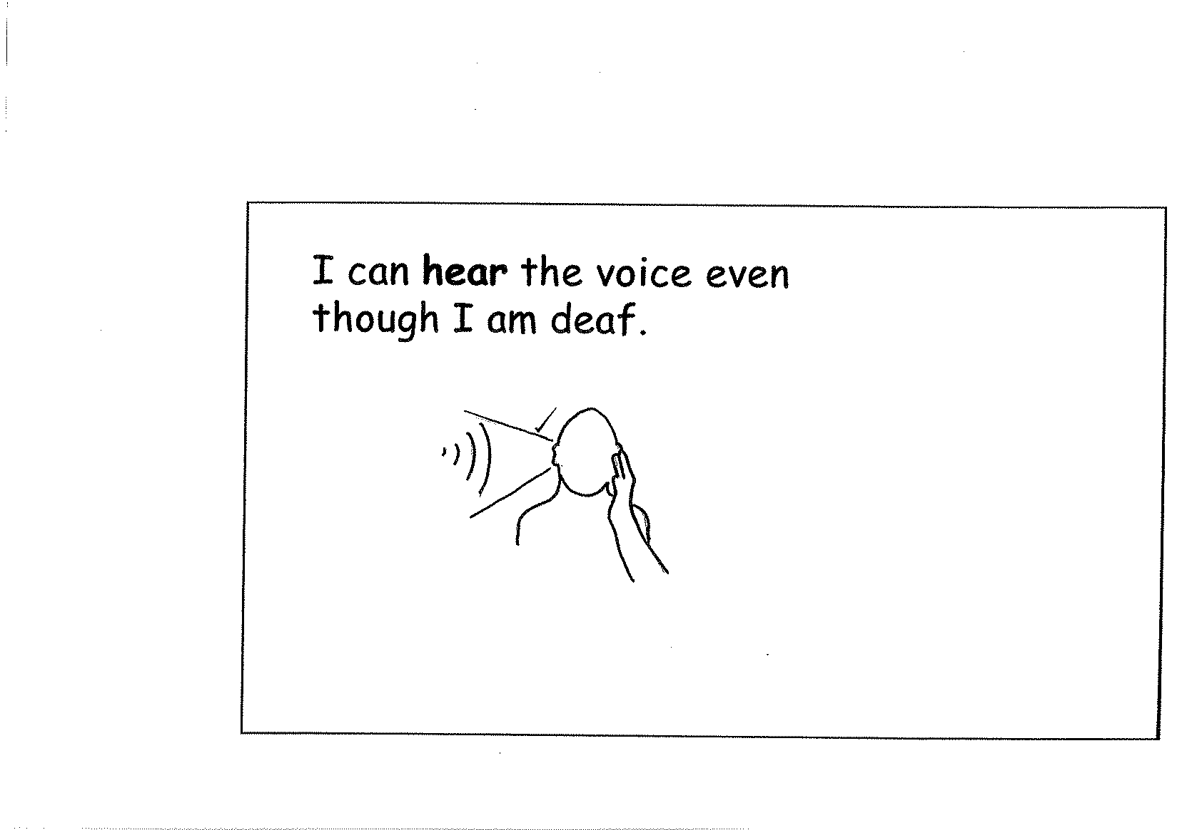

Slide 19
Model of health service provision
Tertiary
Secondary
Primary
Hearing
Deaf

Slide 20
UK Deaf Mental Health services
The current Deaf inpatient services are:
London – Bluebell Ward, Springfield University Hospital
Birmingham – Jasmine Suite, the Barberry
Manchester – The John Denmark Unit

Slide 21
Community services
Birmingham
Manchester
London and the South of England
North East – North East Mental Health and Deafness Service
South Yorkshire – South Yorkshire Service for Deaf People with Mental Health Needs
Nottinghamshire – Nottingham Mental Health and Deafness Team
Bristol – Avon & Wiltshire Partnership Specialised Deaf Service.

Slide 22
Community services
Mental Health and Deafness Service NI
Republic of Ireland – funded by Deaf organisation but pressure for it to be properly funded by health authority
Scottish Mental Health Service for Deaf People
Wales developing a community service

Slide 23
National Deaf CAMHS
North – Manchester, Newcastle and York
South – Cambridge, London and Taunton
Central England – Dudley, Nottingham
and Oxford.
Inpatients – Corner House, Springfield University Hospital

Slide 24
Forensic Deaf Services
National High Secure Deaf Service –
High Security, Rampton Hospital, Retford.
3 medium secure units, independent sector
(one of which is female)
2 low secure units, independent sector

Slide 25


