Slide 1
How do inadequate room acoustics in schools affect the listener?
Background information:
Pyschoacoustics is the scientific study of the psychological and physiological responses associated with sound. Which means, the study of how people perceive, interpret and react to sound. Whilst there may be similarities across these domains, individual responses enviably vary – what might be a pleasant listening experience for one individual, may well be not so pleasant to somebody else. However, the acoustics of the location may enhance or degrade the listening experience.
The Acoustic Scene
The acoustic scene is perhaps best understood through using the analogy of optical illusion. When presented with a visual image, the eyes and the brain attempt to make sense of what is presented. For instance, in the image, right, some may see the profile of a young woman with dark hair – located at the left side of the imaged. Others may see a side profile of an older woman wearing a different headpiece.
What is seen by the viewer is influenced by how well the visual system is working but also through personal previous experience – if neither, or similar, images have ever been presented to the eyes the image is then less familiar and most likely will need to be explained to the viewer.

Slide 2
The Acoustic Scene cont…
Similarly, all sounds occurring within an environment are collectively known as the acoustic scene. When presented with an acoustic scene, the listener’s brain attempts to analyse the scene. Successful analysis depends upon several factors; including how effective the auditory system is but also the listener’s previous exposure to the sounds presented.
In the acoustic scene represented in image A, an individual may hear the orchestra as one sound, (as presented in figure B). Another individual may be able to distinguish between the sounds of different families of instruments, the string section from the brass section, perhaps. Those with more exposure to classical music may very easily detect the frequency specifics of many musical instruments, and identify the differences between a violin and a viola, a trombone from a tuba -as represented in figure C.
It is no co-incidence that musical performance halls tend to have good acoustics – designed to enhance the listener’s experience.

Slide 3
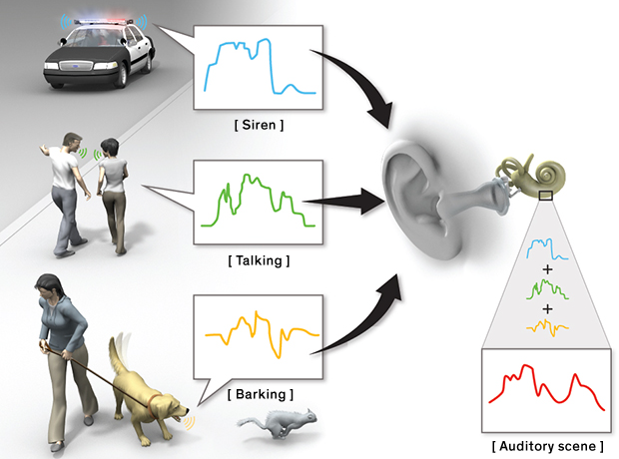
What happens when speech is part of the auditory scene?
Listening to speech in an acoustic scene, commonly referred to as ‘listening to speech in noise’ is an acquired skill that is thought develops fully, in typically hearing children, around the age of 10 to 12 years.
During this process, the auditory scene is captured by the auditory system where it is then analysed by the brain. The analysis of which is influenced by several factors including:
loudness of the speech compared to background noise levels
clarity of the speech
individual language levels of the listener
familiarity with the context
acoustics of the environment
Source: www.mobilemonitoringsolutions.com

Slide 4
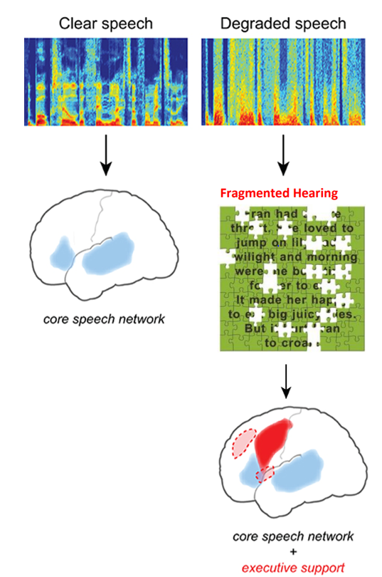
What happens in the brain when speech is degraded by inadequate room acoustics?
When speech is clear, neural activity is largely confined to the language sections of the brain - the ‘core speech network’.
When speech is degraded, it often results in fragmented hearing.
Subsequently, attempting to access degraded speech places a greater demand upon the brain. In order to do this, support from other areas of the brain is needed.
Consequently, the brain’s capacity to perform other tasks is then compromised - specifically those involving executive functioning skills.
Source: amended from ResearchGate and SuccessForKidsWithhearingLoss

Slide 5
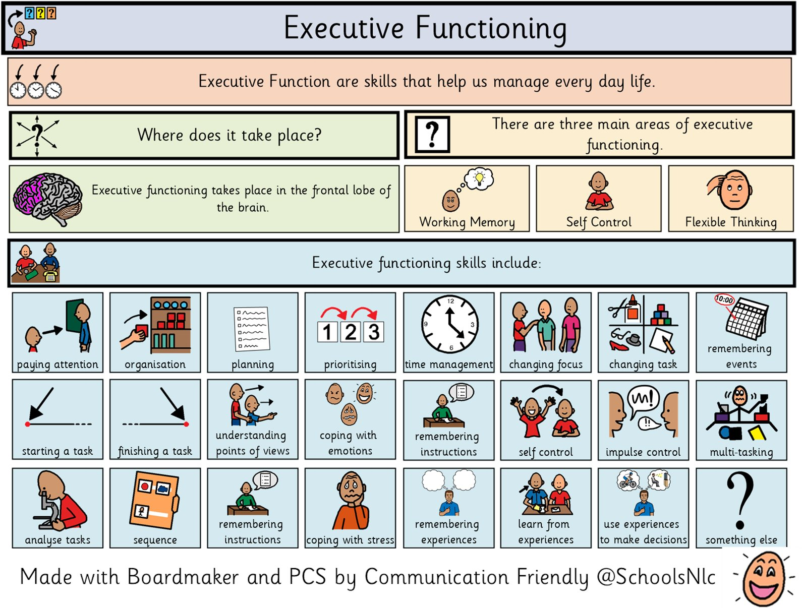
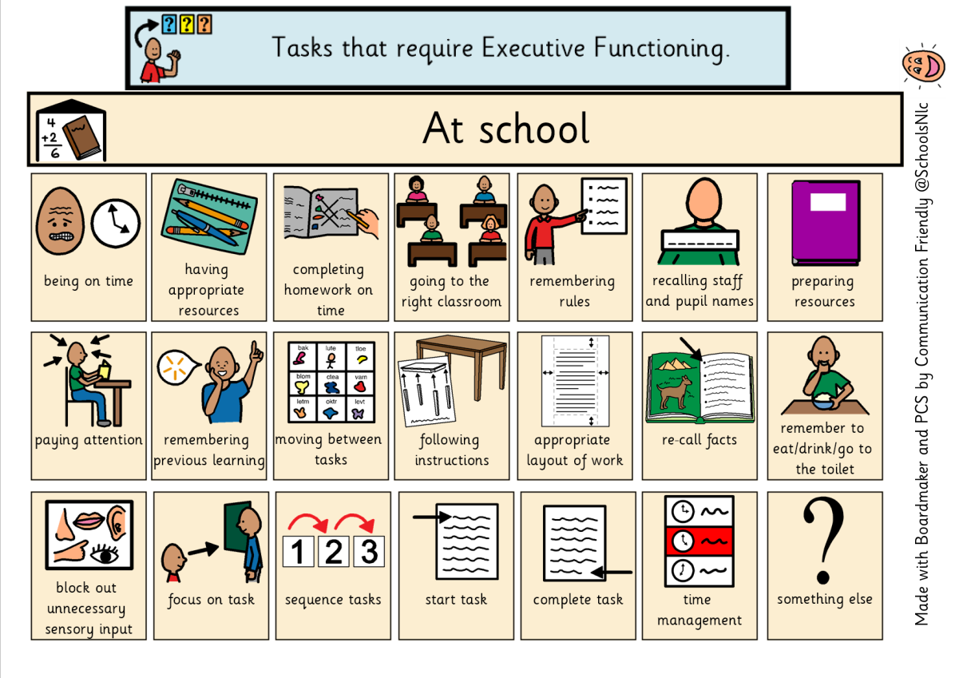
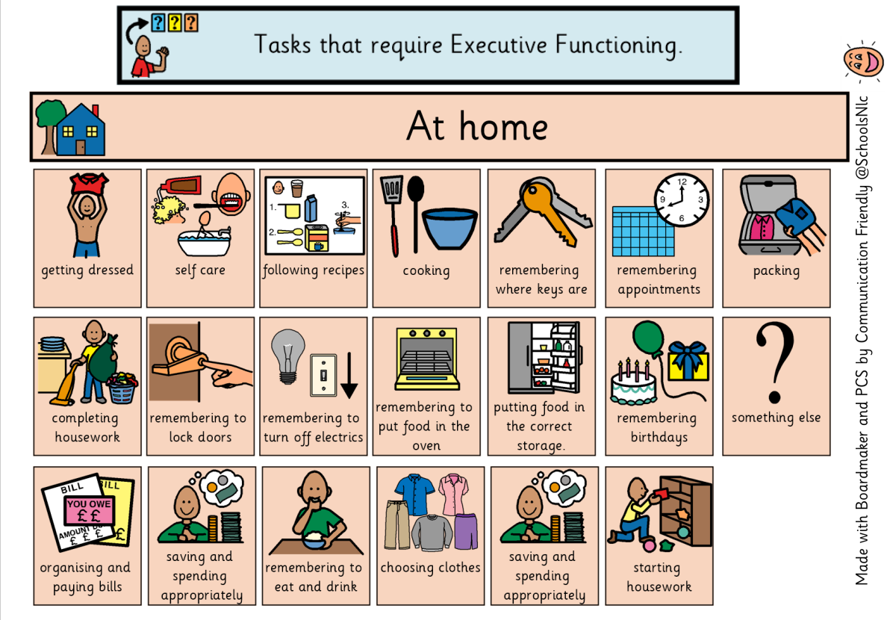
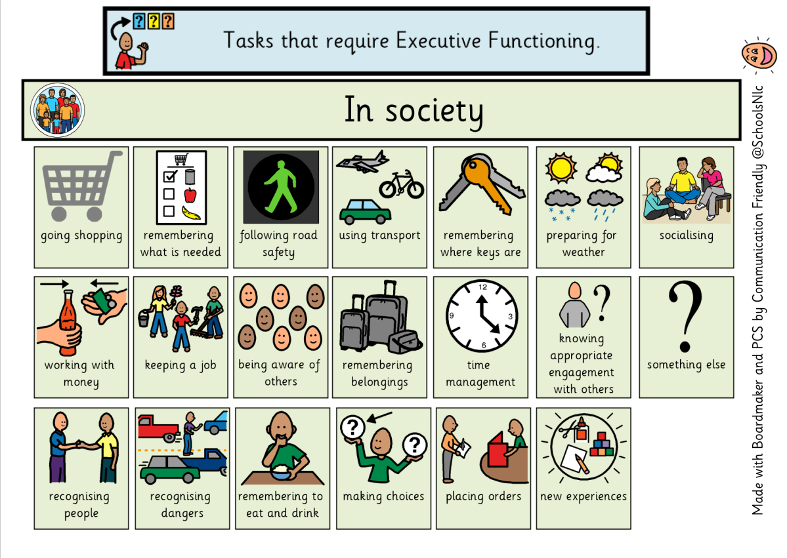
What are executive functioning skills?
Executive functioning skills are needed for everyday life, not only in school but in the home and also in the community.
The areas of working memory, self-control and flexible thinking are three main areas of executive functioning.
NB. Children and young people presenting with executive functioning difficulties,as depicted in the accompanying images, have the potential to be incorrectly identified with a range of special educational needs.

Slide 6
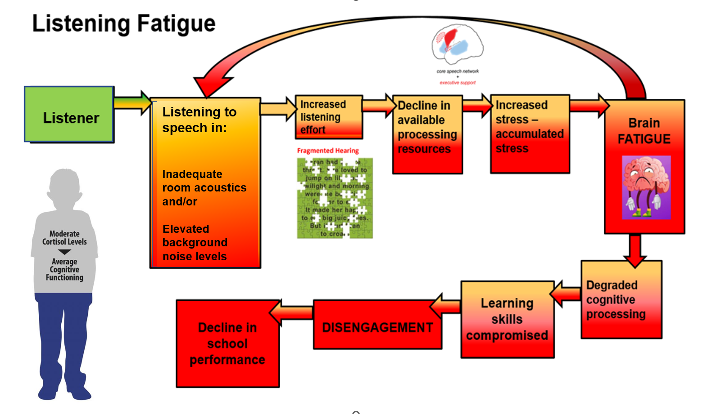
Additionally, listening to degraded speech for extended periods has the potential to compromise long term academic engagement, progress and achievement for learners of all ages.
Source: Own complication

Slide 7
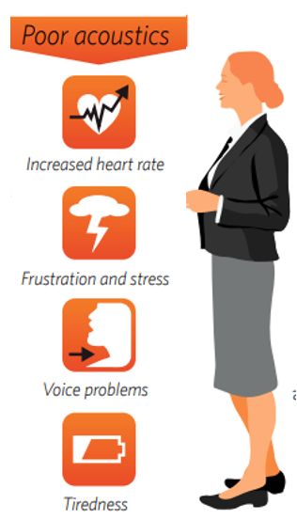
Are teachers affected by inadequate room acoustics?
Literature highlights inadequate acoustics in educational settings to be not only detrimental to learners but also to teaching staff. Many of whom cite negative, physiological and psychological effects of working in classrooms with inadequate room acoustics.
Open Plan Classroom Noise and Teacher Personality
Saint Gobain Ecophon 2018
The selected font for WCO is Verdana (acousticbulletin.com)
Noise – a stressor? Acoustic ergonomics of schools
Tiesler and Oberdorstor, 2008
Noise — A Stressor? Acoustic Ergonomics of Schools - Gerhart Tiesler, Markus Oberdörster, 2008 (sagepub.com)
Inclusive Acoustic Design for Mainstream School – an Evidence Based Approach
Greenland, James and Harvie-Clark, 2023
Inclusive-Acoustic-Design-for-Mainstream-Schools-An-Evidence-Based-Approach-References.pdf (andersonacoustics.co.uk)
Source: Ecophon

